Slide 1

Getting Started with Data Analysis & Visualization Introduction to Python
Kaitlin Throgmorton, MLIS Data Librarian for the Health Sciences

Slide 2



Before We Begin
Welcome!
Interrupt if you have questions – especially when we start coding. (If you have a question, others probably do, too!)
The best way to get my attention is to unmute, but I’ll also check for raised hands and chats.
You will get these slides, code, and more after this session ends.

Slide 3

Today’s Goals
Understand basic programming concepts
Write code in Python
Analyze data in Python

Slide 4

Common Ground

Slide 5
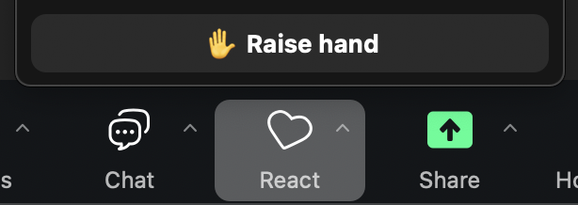
Activity
Raise your hand in Zoom (React > ✋ Raise Hand) if any of the following statements apply to you.

Slide 6

Gaming
You enjoy playing games.
✋ Raise Hand if this applies to you.
Notes:
This can be any type of game at all! Anything from Wordle to mobile phone games to video games to Scrabble to chess to card games to Dungeons and Dragons.

Slide 7

Problem Solving
You solve problems in your work and / or studies.
✋ Raise Hand if this applies to you.
Notes:
This can be any type of problem! Problems in the hospital, the lab, the classroom, for assignments, for projects, anything!

Slide 8

Language
You’ve learned new language concepts.
✋ Raise Hand if this applies to you.
Notes:
This can be in any language at any time – in your native language, or a second language – and very recently, or as far back as grade school.

Slide 9

First Time Using Python
This will be your first time coding in Python.
✋ Raise Hand if this applies to you.

Slide 10

First Time Coding
You’ve learned new language concepts.
✋ Raise Hand if this applies to you.

Slide 11
Why learn Python?
Popular
Versatile
”Readable”
Notes:
Among the most popular programming languages — and increasingly, the first language computer programming language people learn. Python is very versatile — you can automate tasks, analyze data, build websites, and more with Python. Also, for a computer language, it has a simpler structure (called syntax) than some other languages. Because of its popularity, it also has a big community, and a lot of libraries, toolkits, and guides.

Slide 12


What to Know Before We Code

Slide 13
General terms and concepts
Coding — solving problems with a computer programming language
Programming — the entire range of activities that happen before, during, and after large-scale coding such as planning, research, design, writing and running code, testing, troubleshooting, improving, maintaining
Integrated development environment (IDE) — software designed specifically for coding, often in a particular language, which has features meant to improve your coding experience
Notes:
A form of problem-solving. If you like Wordle, puzzles, Rubik’s cubes, video games, crosswords, Sudoku, or really any kind of problem-solving (like diagnosing a patient, running experiments, or helping students learn something new) … you might discover coding is just another way to problem-solve, and might even be fun sometimes.
A more formal definition: coding involves learning a programming language (its syntax, its semantics, its construction) so you can translate human speaking and language, conceptualizing, and problem-solving into machine-readable code.
Coding involves actually writing and running scripts. Programming is a much broader activity, which can involve research, design, analysis, and more. We’re going to mostly focus on coding today, but we’ll take the first steps of programming towards the end.
Wikipedia’s definition: “Programming involves tasks such as analysis, generating algorithms, profiling algorithms' accuracy and resource consumption, and the implementation of algorithms (usually in a chosen programming language, commonly referred to as coding).”
Don’t let ‘algorithm’ intimidate you — Wikipedia, again, defines it as “a finite sequence of well-defined instructions.”

Slide 14
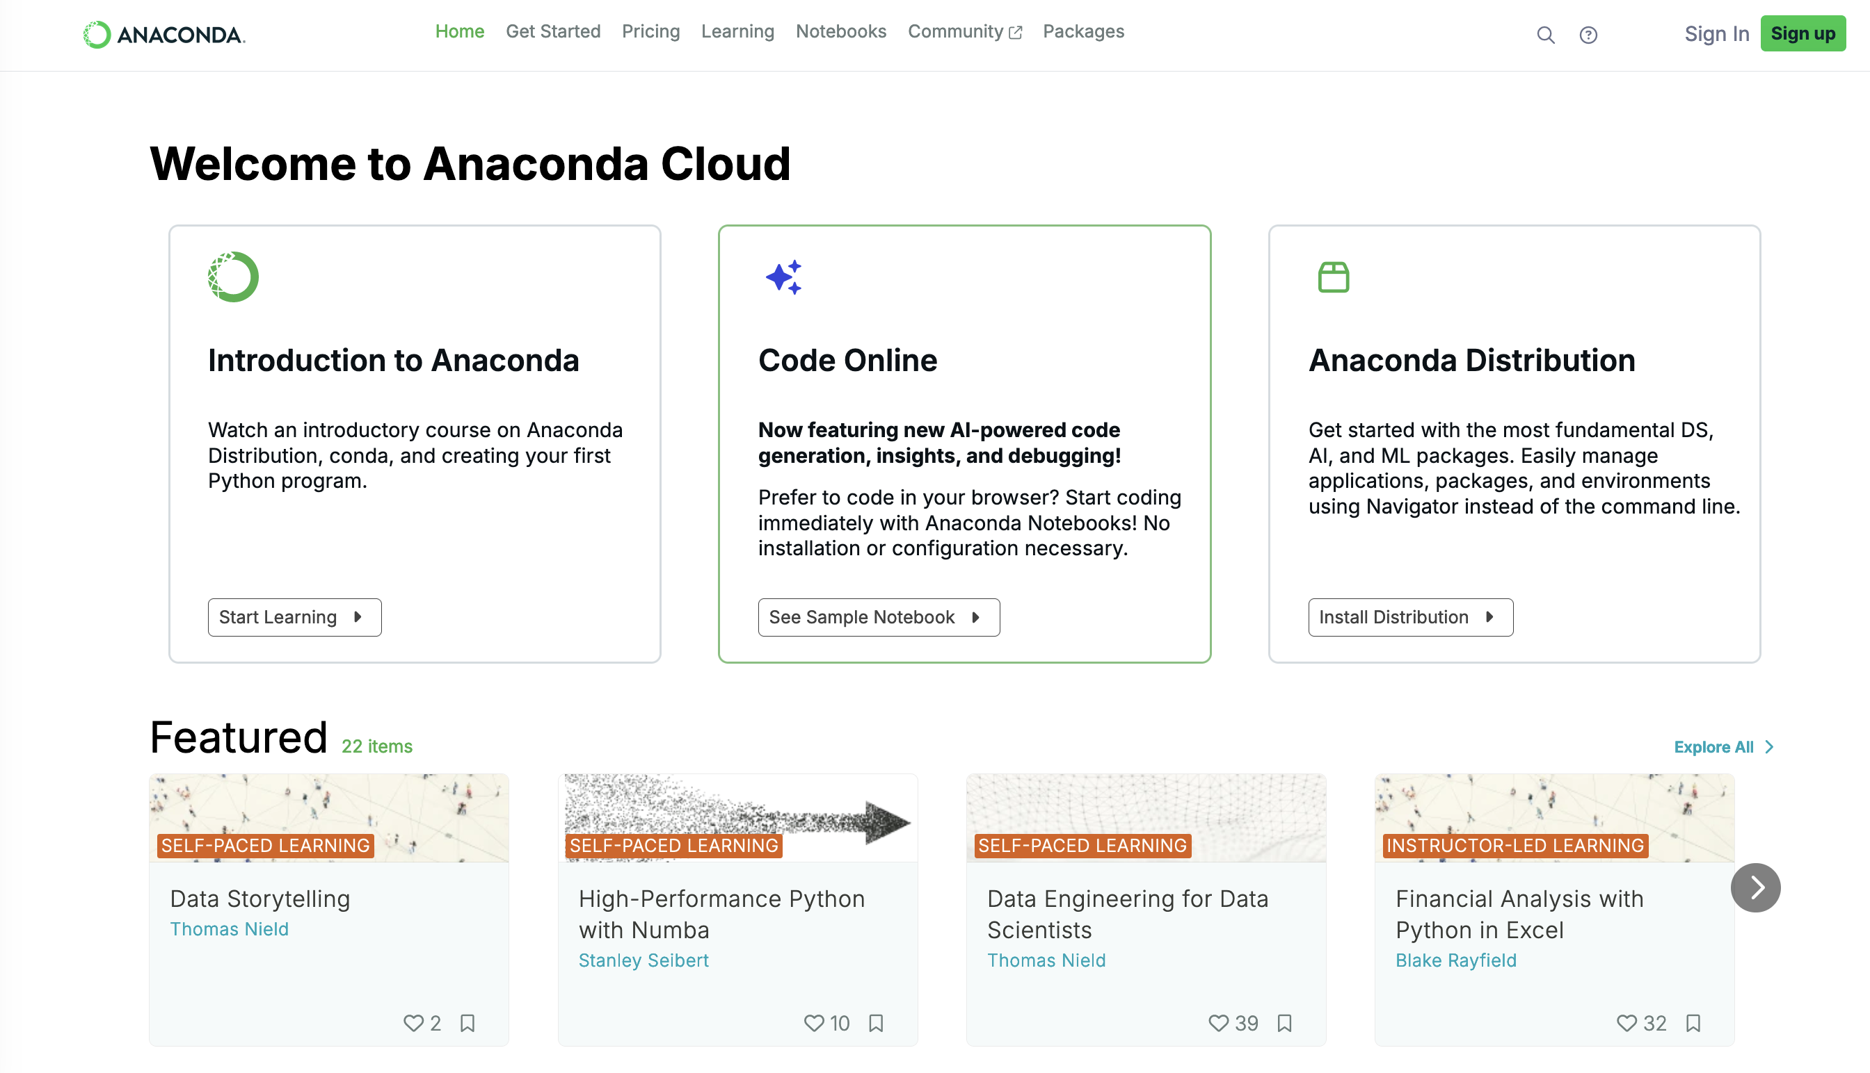
We’ll use Anaconda Cloud to code: https://anaconda.cloud/sign-up
(Sign-up is free!)

Slide 15
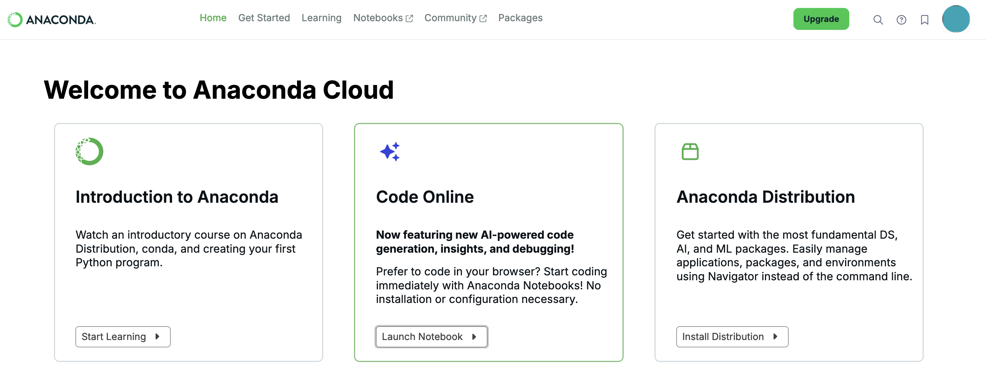
Once signed in, click Launch Notebook.

Slide 16
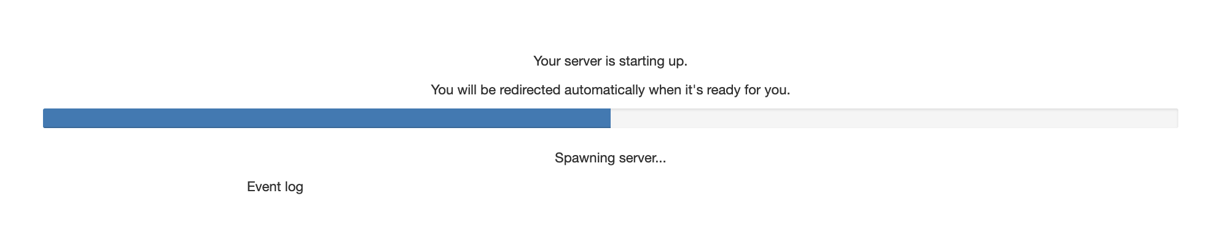
It make take a few moments for the notebook to launch…
(And if it says “server not running,” click Launch Server.

Slide 17
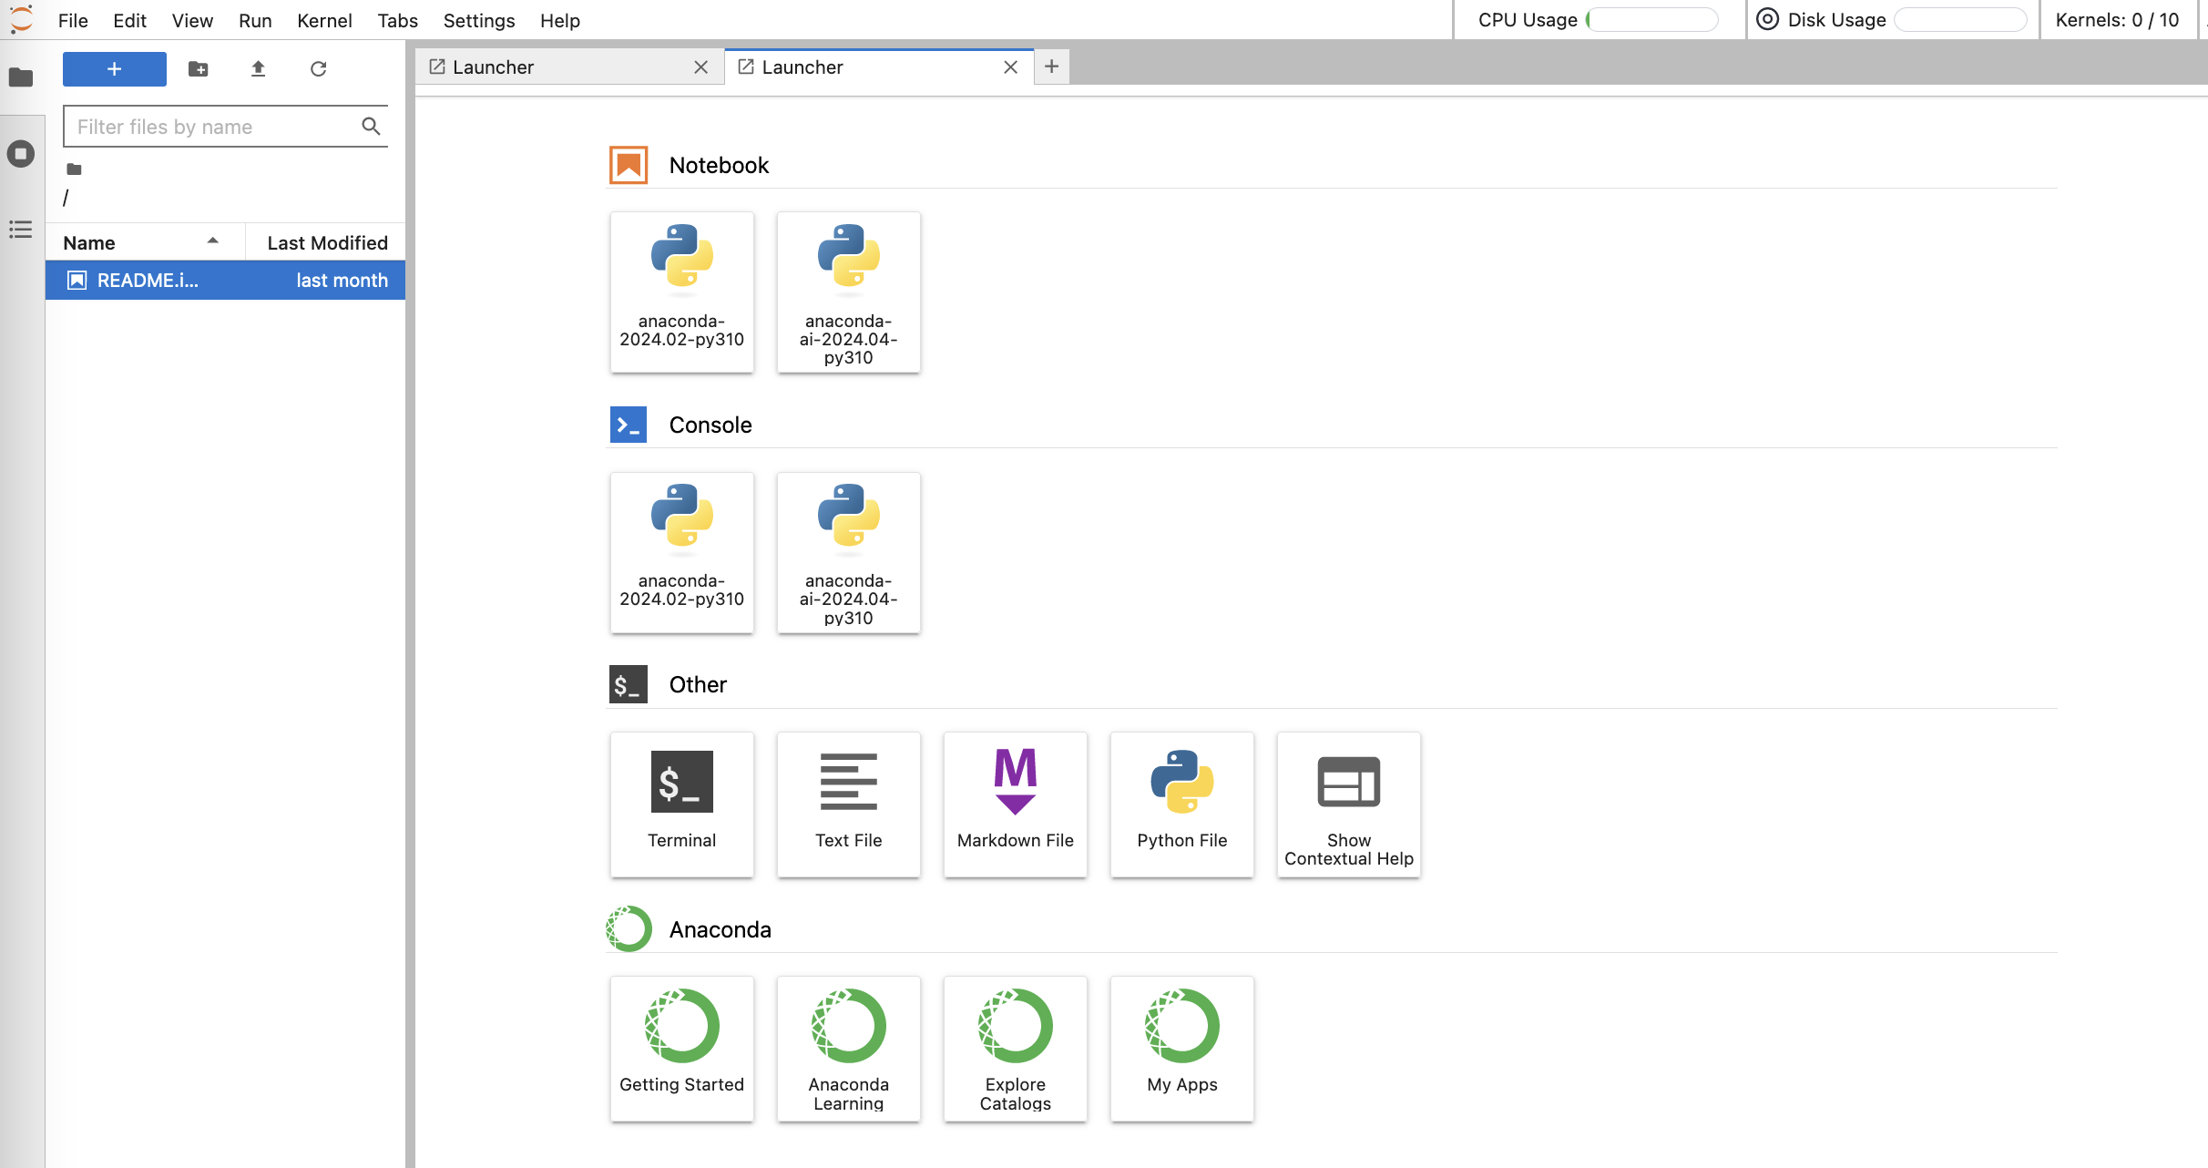
If prompted to select a kernel, choose the first option from the list, usually anaconda-2024.02-py310. Then choose the anaconda-2024 notebook (not the ai notebook).

Slide 18
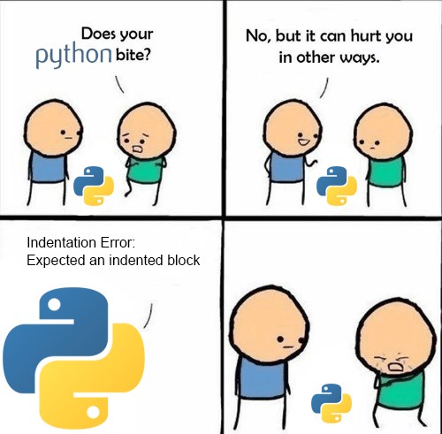
One more thing…
It’s okay to make mistakes!
Troubleshooting (i.e., debugging) is part of everyone’s day-to-day experience with coding, even for experts.
Via the Reddit community r/ProgrammerHumor

Slide 19

Python basics
x = 75

Slide 20
General terms and concepts
Syntax — set of rules in a programming language; works similarly to syntax in spoken languages
Code input — the code you type
Code output — what’s displayed when you run your input
Program, or script — one or more lines of code, usually meant to do something, such as a task, transformation, visualization
Functions — a command in a programming language; these can come standard in a language, be custom-written, or utilized via add-on modules

Slide 21
Python terms
Strings — essentially text; technically arrays of bytes representing Unicode characters
Syntax: enclosed in quotes, either single or double ( ' ' or " " )
In this course, we will use double quotes
Integers and floats — numeric data types; integers are whole numbers and floats contain decimals
Lists — used to store multiple items in one variable
Syntax: enclosed in brackets, [ ]
Variables — contain information that can change over time; this information can be text, numbers, lists, other data types

Slide 22

Next steps: Using Python to work with data
x = 75

Slide 23




Setting the scene
environment
import tool as t
import viztool as viz
library/package/tool
thing = t.function()
viz.function(thing)
input/code/functions
output/viz

Slide 24
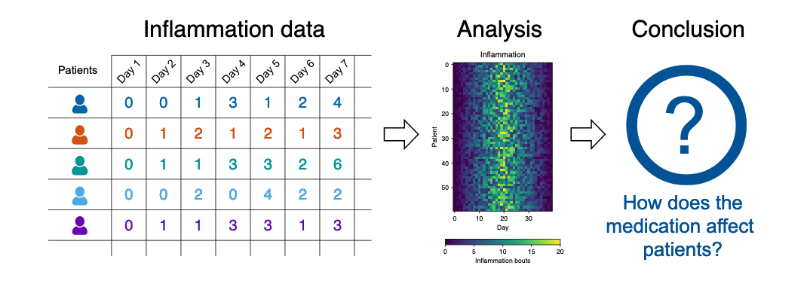
Our Scenario
Image credit: The Carpentries.
Notes:
Scenario: A Miracle Arthritis Inflammation Cure
Our imaginary colleague “Dr. Maverick” has invented a new miracle drug that promises to cure arthritis inflammation flare-ups after only 3 weeks since initially taking the medication! Naturally, we wish to see the clinical trial data, and after months of asking for the data they have finally provided us with a CSV spreadsheet containing the clinical trial data.
The CSV file contains the number of inflammation flare-ups per day for the 60 patients in the initial clinical trial, with the trial lasting 40 days. Each row corresponds to a patient, and each column corresponds to a day in the trial. Once a patient has their first inflammation flare-up they take the medication and wait a few weeks for it to take effect and reduce flare-ups.
To see how effective the treatment is we would like to:
Calculate the average inflammation per day across all patients.
Plot the result to discuss and share with colleagues.

Slide 25
Our Data
In CSVs where:
Rows = Patients (n = 60)
Columns = Days (n = 40)
Shape of data = 60 x 40
Image credit: The Carpentries.

Slide 26
Our Plan
Calculate the average inflammation per day across all patients.
Plot results.
Image credit: The Carpentries.

Slide 27
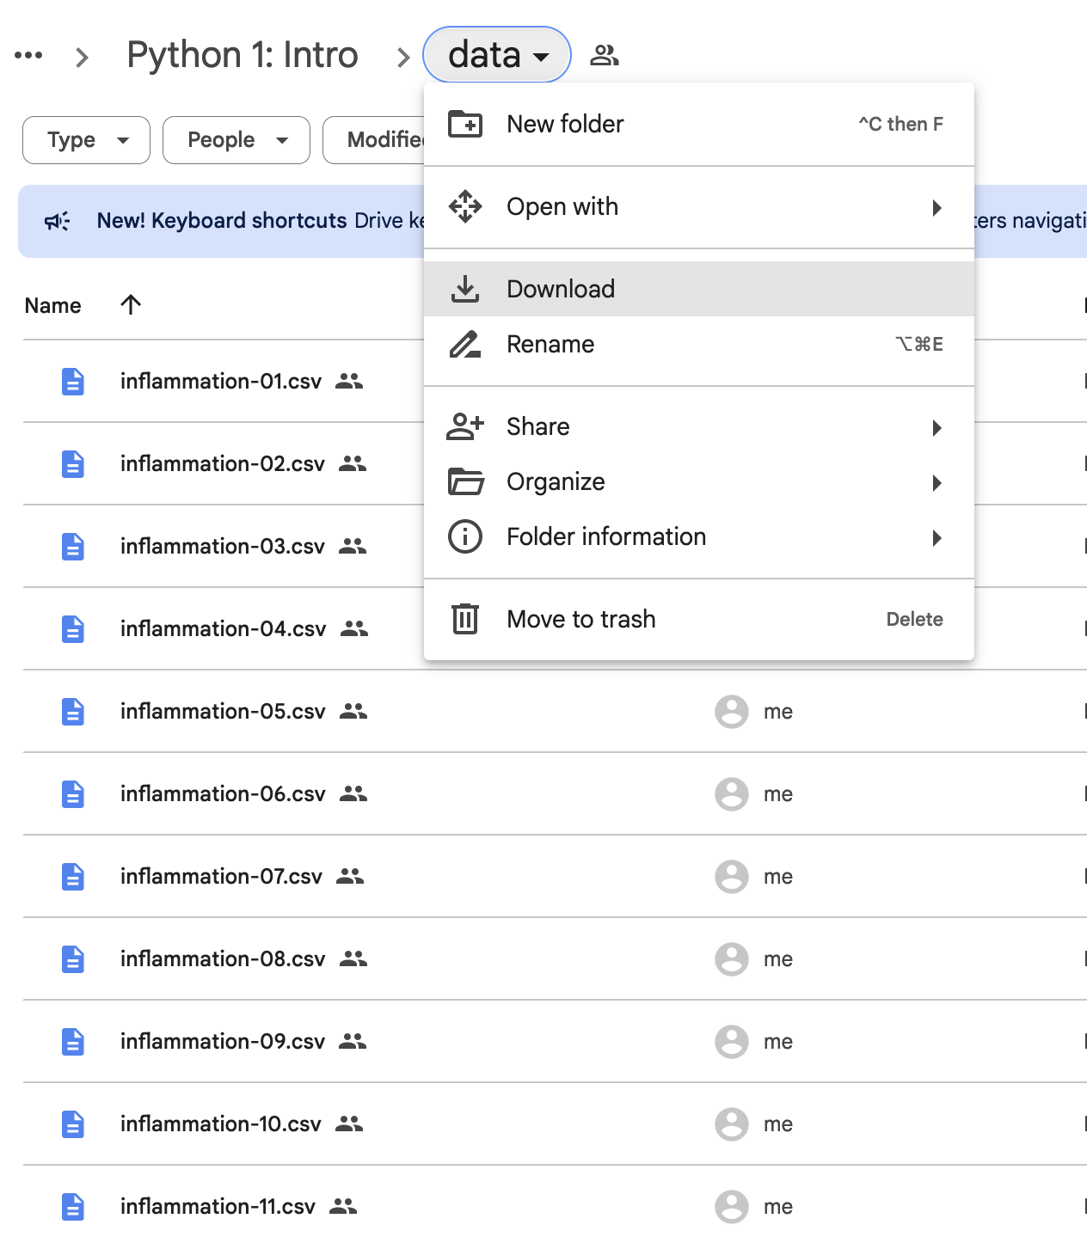
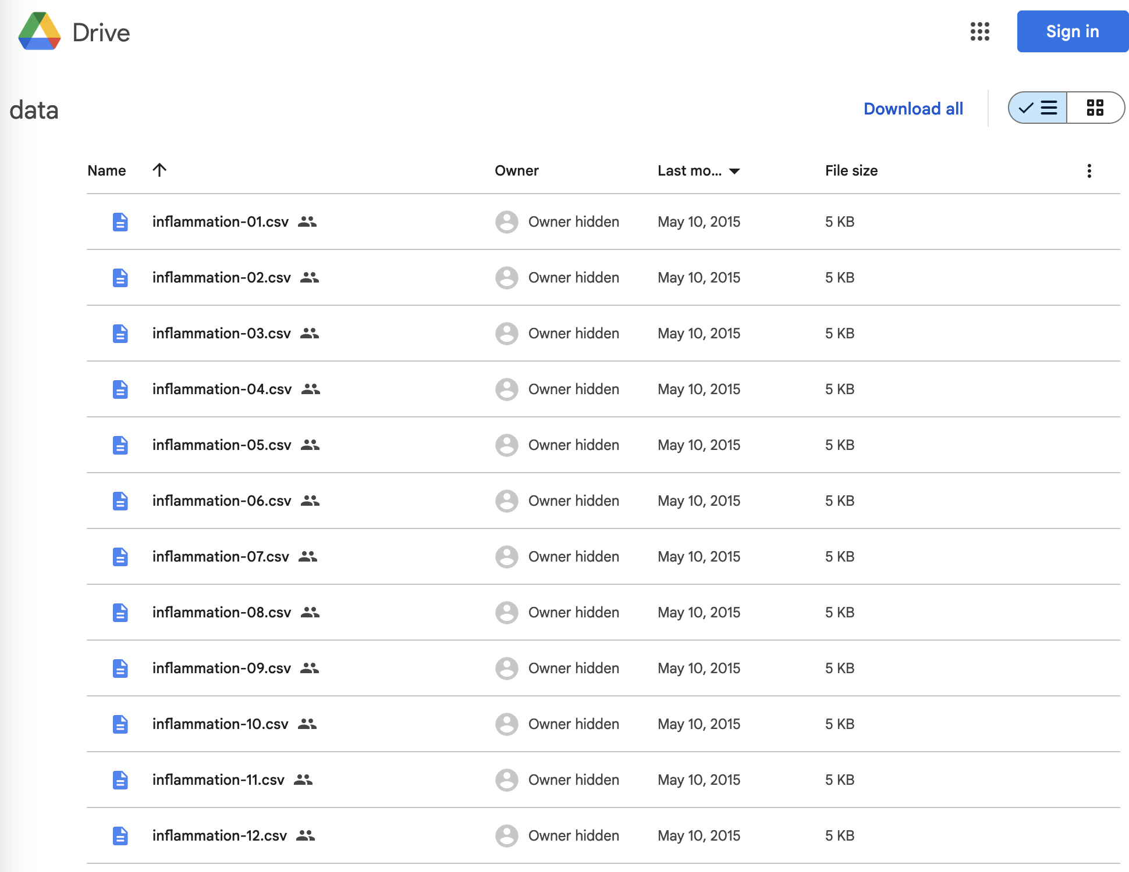
OR
Go to https://tinyurl.com/python-data-cwml to download

Slide 28
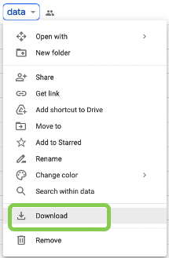
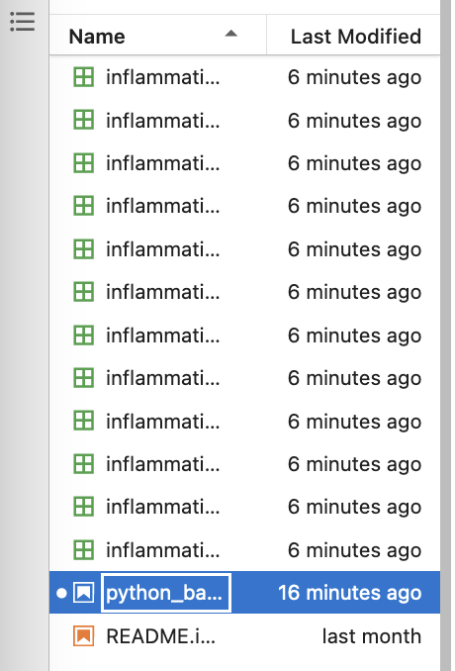


Downloading and organizing files
Download the entire Google Drive folder.
Go to your Downloads folder (via Finder on Mac; File Explorer on Windows) and unzip the .zip file.
In Anaconda Cloud, use the upload button to upload the files into your environment (after step #1 and #2, they should be located in Downloads > data).

Slide 29

Upload files in the top left corner – look for this icon:

Slide 30
Onto using Python to work with data
x = 75

Slide 31

Illustrations

Slide 32
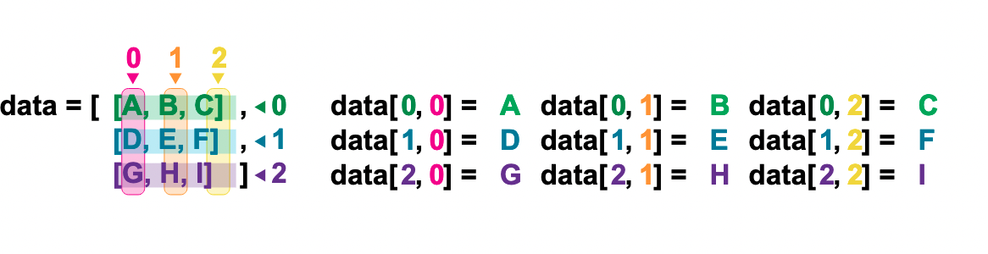
Indexing in numpy
Indexing a numpy data array in Python.
Image credit to the Carpentries, from this lesson, and thanks to a CC-BY-4.0 license.

Slide 33
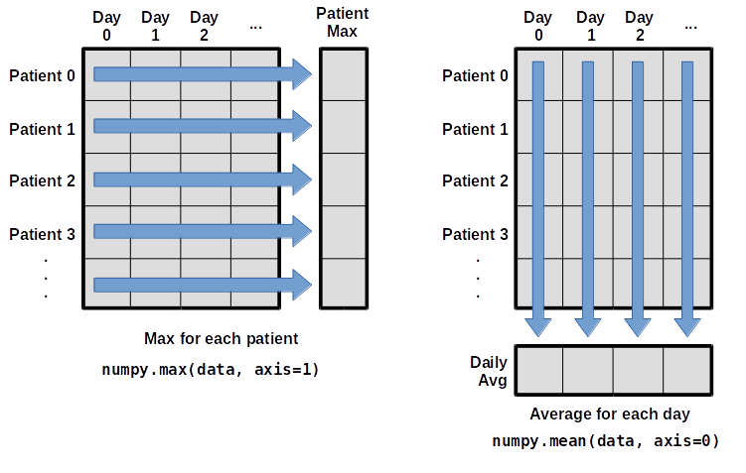
Using axes in numpy
Using array axes in numpy in Python.
Image credit to the Carpentries, from this lesson, and thanks to a CC-BY-4.0 license.

Slide 34

Parting Words + Resources
x = 75

Slide 35
Top Tips for Learning to Code
Practice!
Start with projects that feel familiar and exciting to you.
Then, try more challenging projects with real-world applications.
Read documentation, cheatsheets, and other people’s code.
Be consistent and document, document, document.
Use standards and conventions where helpful and appropriate — code styles/templates (e.g. PEP8), etc.
Ask for help when you need it — from peers, mentors, the library, the literature, and the internet.
Get more help on CWML’s Learn to Work with Data site!

Slide 36
Upgrading to Anaconda Distribution
Today we worked in Anaconda Cloud.
Many people who code regularly decide to upgrade to Anaconda Distribution for access to full-fledged IDEs and many additional features.

Slide 37
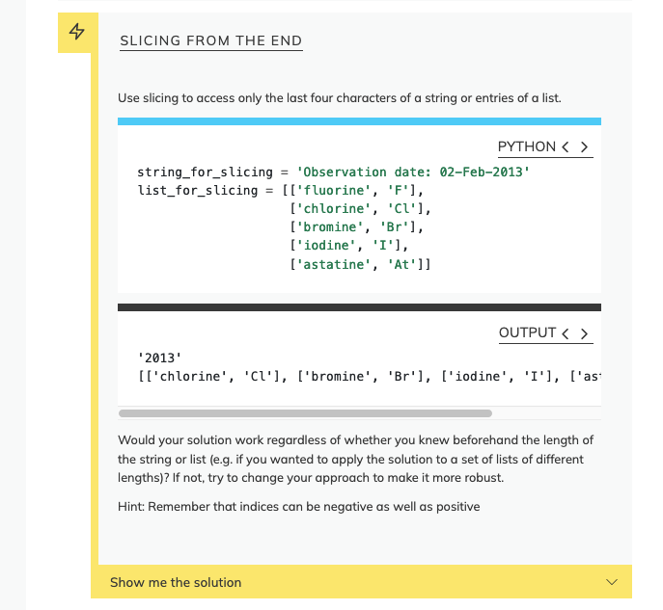
Practice
To practice what we learned today:
Go to the Programming with Python Carpentries lesson book: https://swcarpentry.github.io/python-novice-inflammation/index.html
Select an episode
Find exercises at the bottom, highlighted in yellow -->

Slide 38
Get in touch
Kaitlin Throgmorton
kaitlin.throgmorton@yale.edu
Get more info on the library website:
library.medicine.yale.edu/research-data
P.S. A survey will appear when you exit the Zoom – please take it!

Slide 39
Acknowledgements
Some of this material, including the inflammation data, is adapted from the Carpentries, using a CC-BY-4.0 license.

Slide 40
General Python Documentation
Official Python docs: https://python.org
Beginner guide: https://wiki.python.org/moin/BeginnersGuide
Cheatsheets:
Python: https://www.pythoncheatsheet.org/ + https://www.datacamp.com/cheat-sheet/getting-started-with-python-cheat-sheet
See more helpful learning resources (under Python): https://library.medicine.yale.edu/research-data/learn-work-data

Slide 41
Python Library Documentation
Each library we used today has its own documentation, for further reading.
numpy — docs | user guide
matplotlib — docs | user guide | cheatsheets
glob — docs

Slide 42
Jupyter & Markdown Documentation
Anaconda Cloud – see tutorials and other learning materials at anaconda.cloud
markdown – guide | cheatsheet

Slide 43
Resources
Understanding loops:
Codecademy | Intro to Programming: Loops [YouTube]: do you think in pictures? Watch this video for a great graphical explanation of loops.

Slide 44




Understanding how to get up and running
01
Programming Language
02
Environment
03
Library / Package
04
Function

